Slide 1


SRINIVAS INSTITUTE OF MEDICAL SCIENCES & RESEARCH CENTRE
SRINIVASNAGAR, MUKKA, SURATHKAL, MANGALORE – 574146. D.K
ORIENTATION PROGRAM
1ST YEAR MBBS - ACADEMIC YEAR 2025-26
PLACE: OPEN AUDITORIUM
SRINIVAS UNIVERSITY CAMPUS
27TH OF OCTOBER 2025

Slide 2
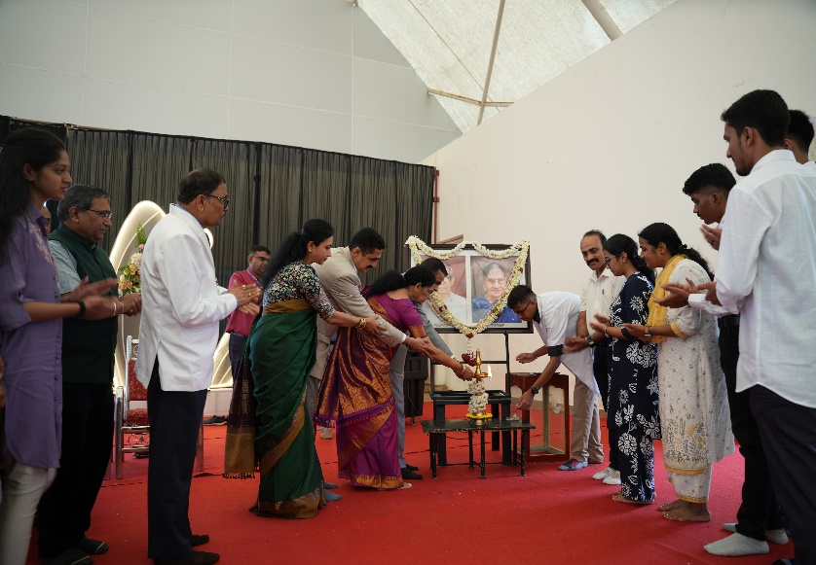
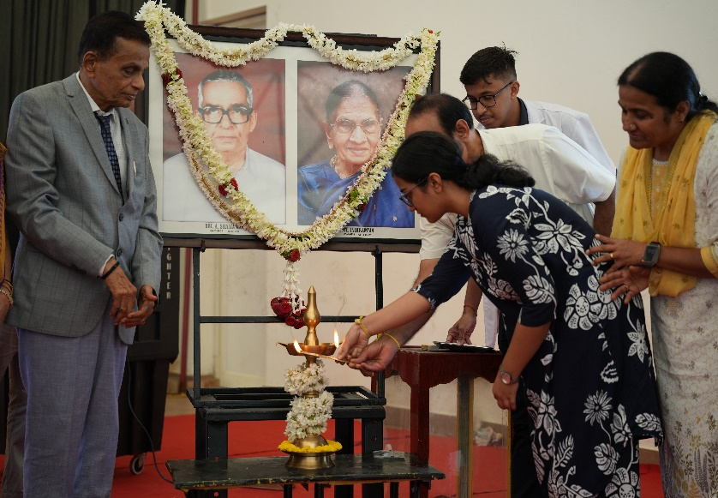
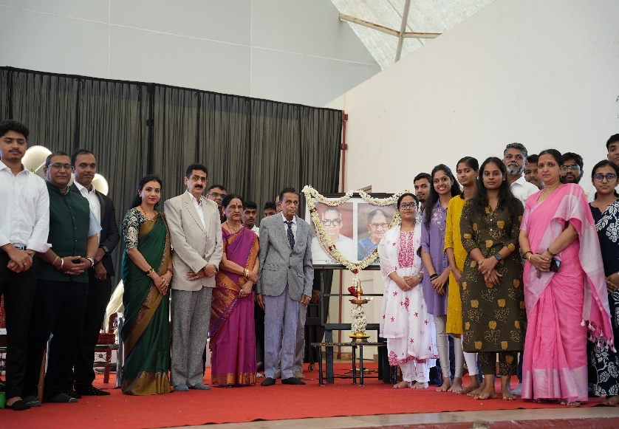
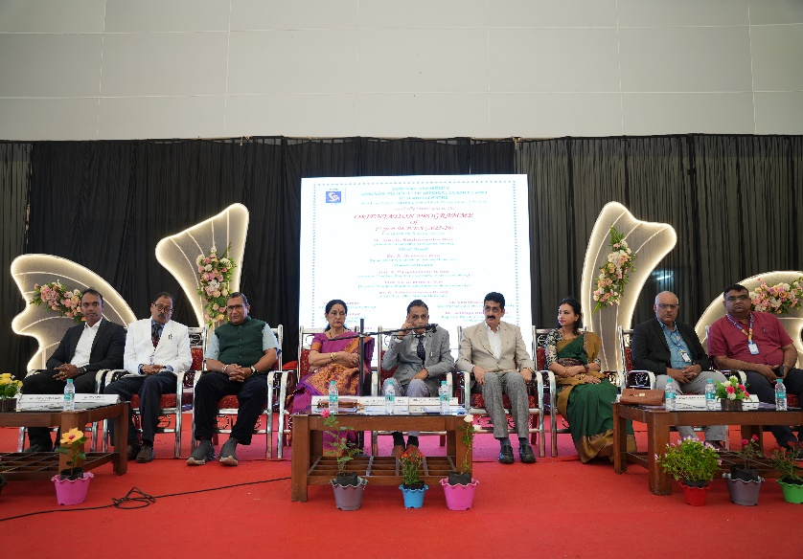
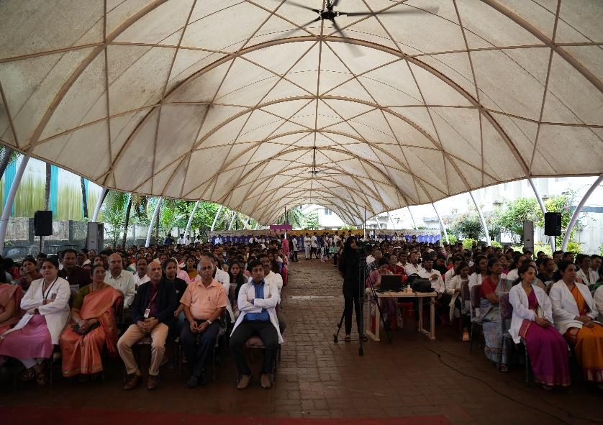
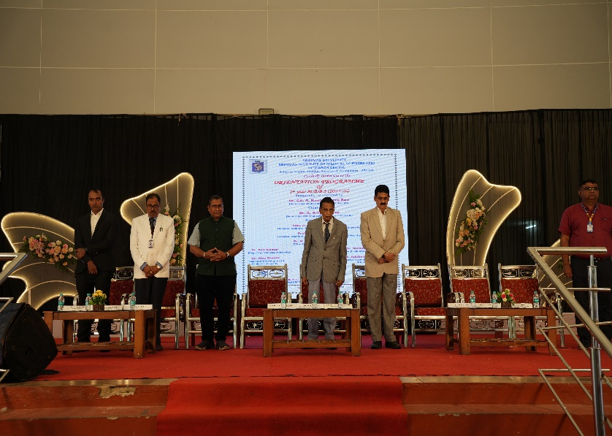
SRINIVAS INSTITUTE OF MEDICAL SCIENCES & RESEARCH CENTRE
SRINIVASNAGAR, MUKKA, SURATHKAL, MANGALORE – 574146. D.K
INAUGURAL CEREMONY

Slide 3
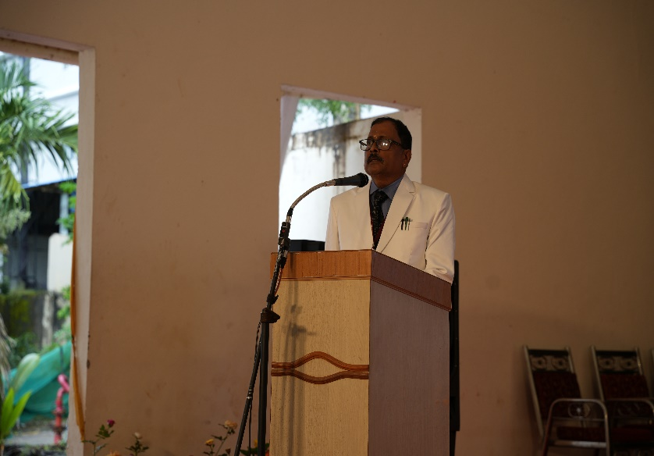
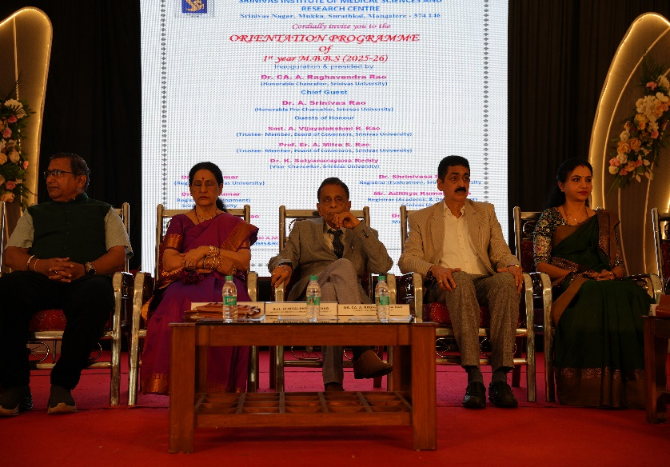
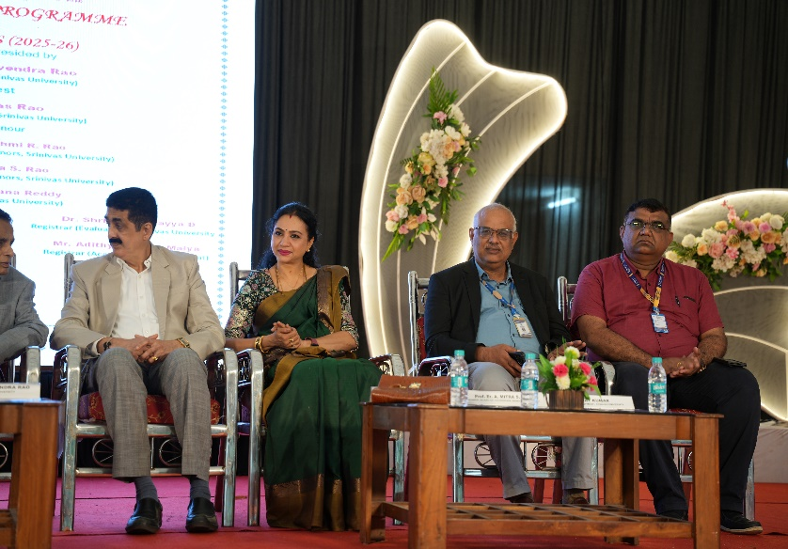
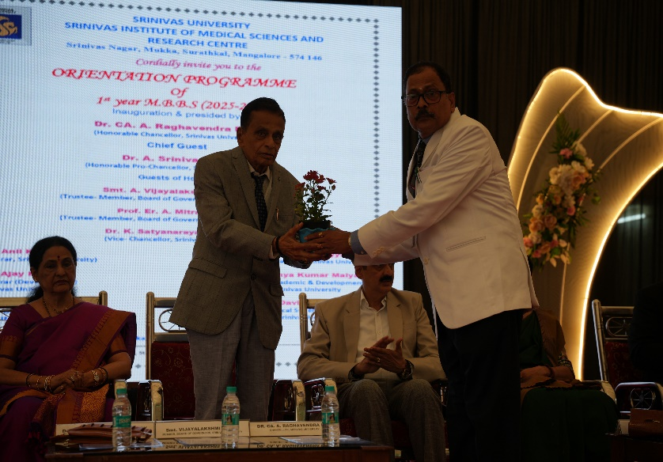
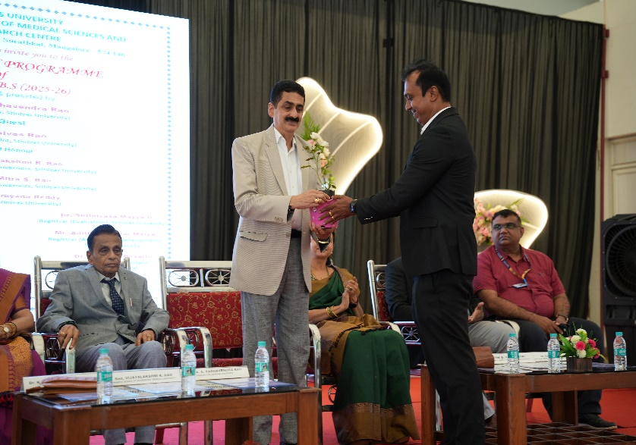
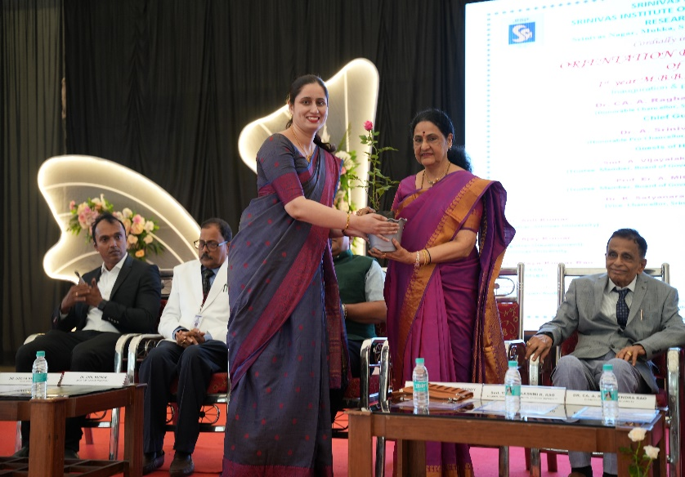
SRINIVAS INSTITUTE OF MEDICAL SCIENCES & RESEARCH CENTRE
SRINIVASNAGAR, MUKKA, SURATHKAL, MANGALORE – 574146. D.K
HONORING OF GUESTS

Slide 4
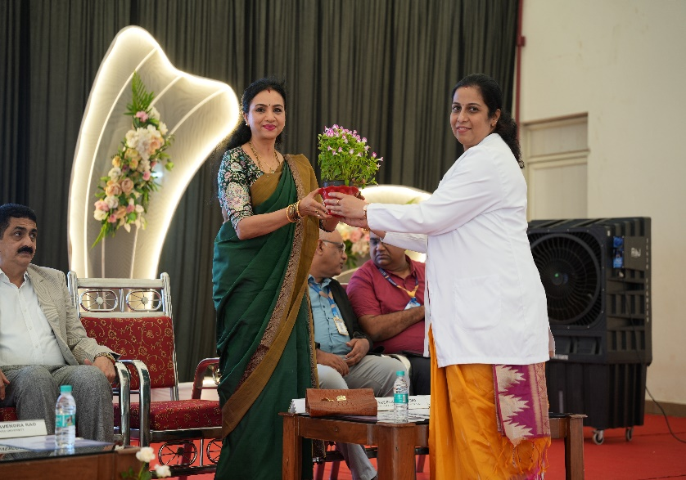
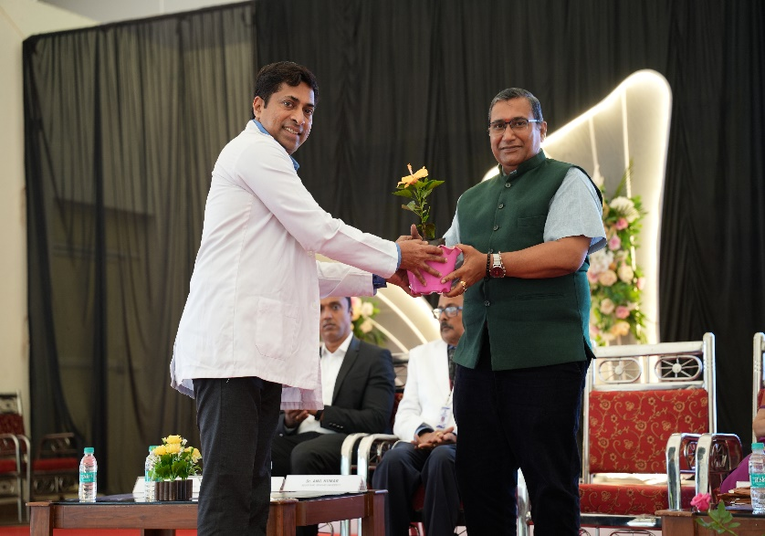
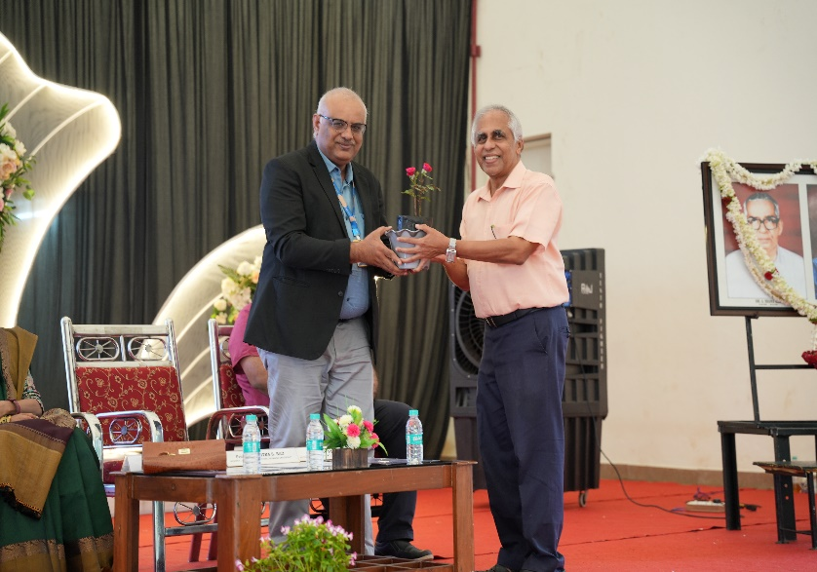
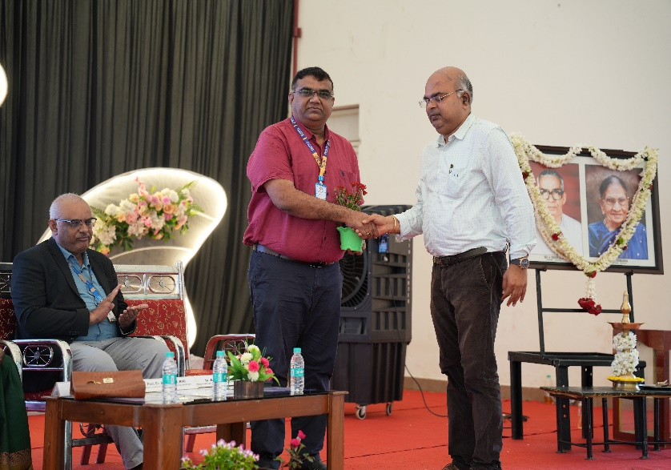
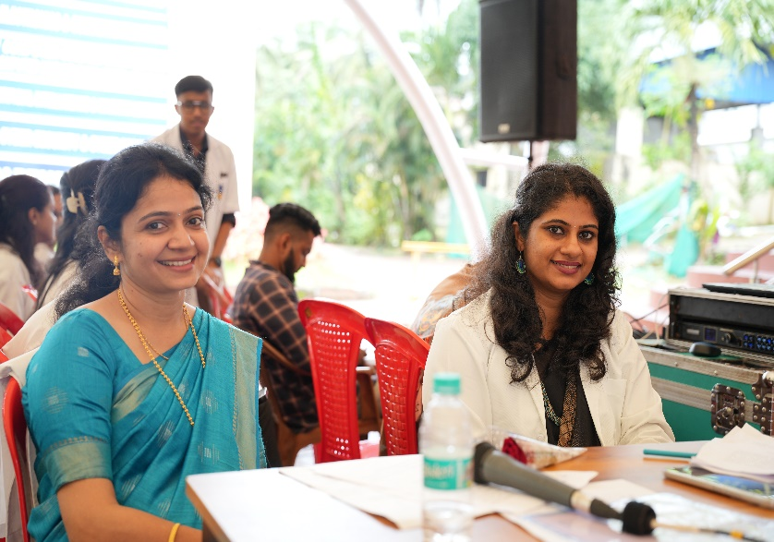
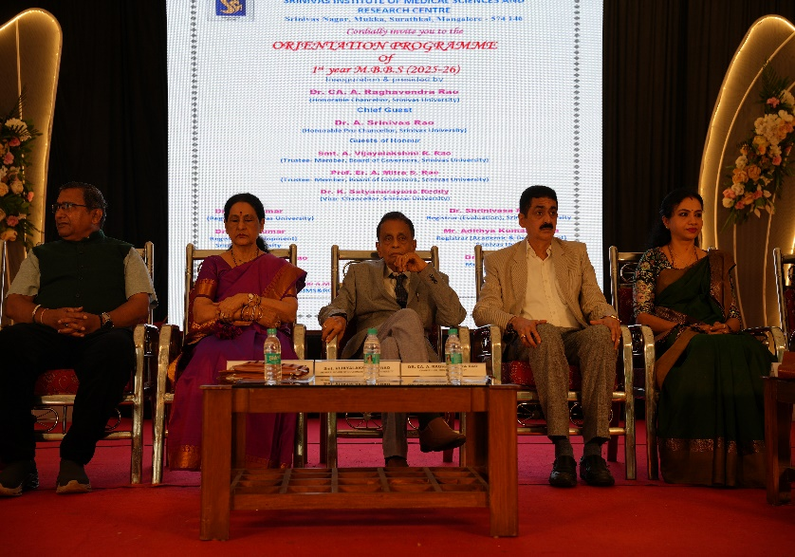
SRINIVAS INSTITUTE OF MEDICAL SCIENCES & RESEARCH CENTRE
SRINIVASNAGAR, MUKKA, SURATHKAL, MANGALORE – 574146. D.K
HONORING OF GUESTS

Slide 5
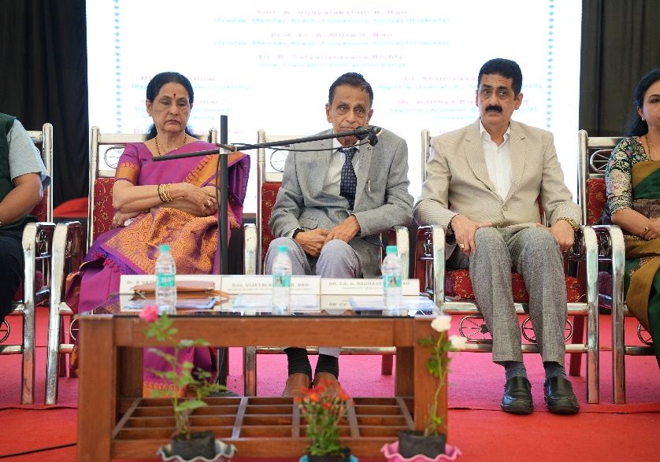
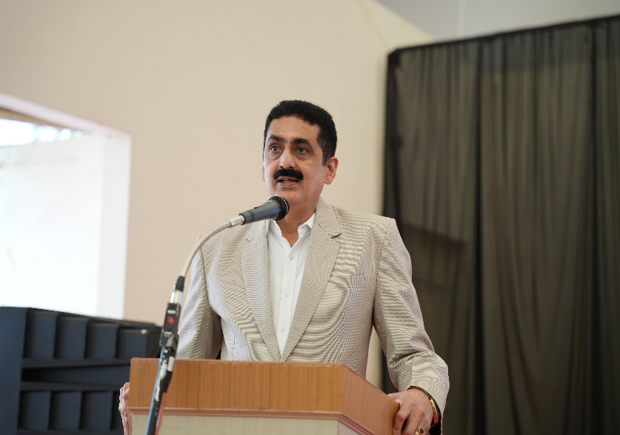
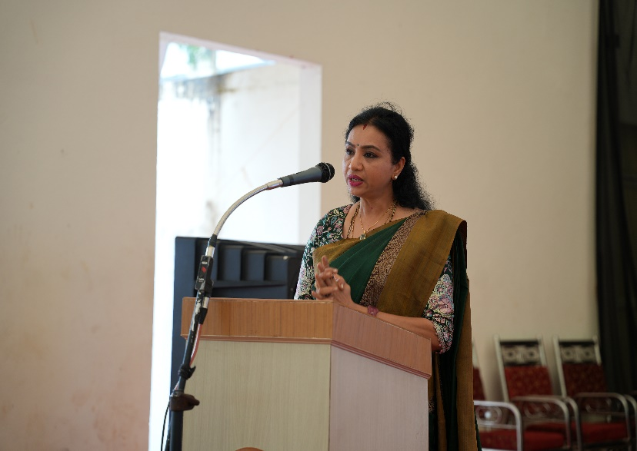
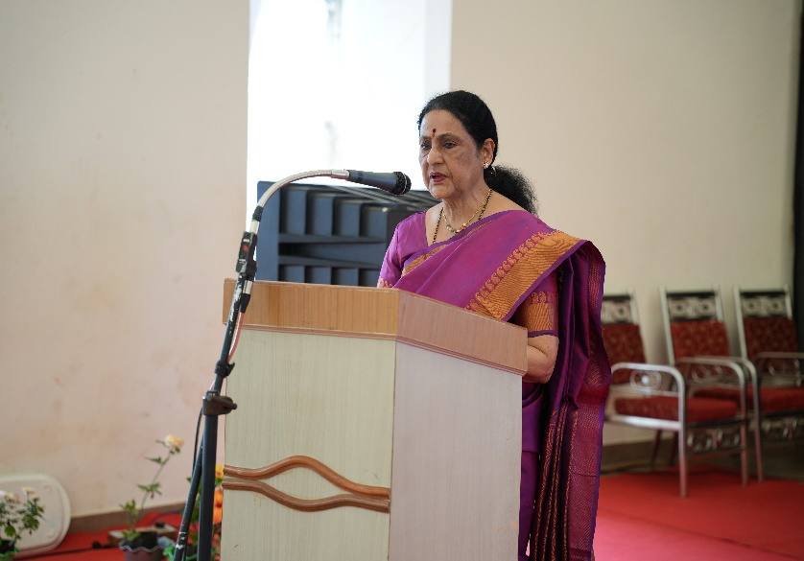
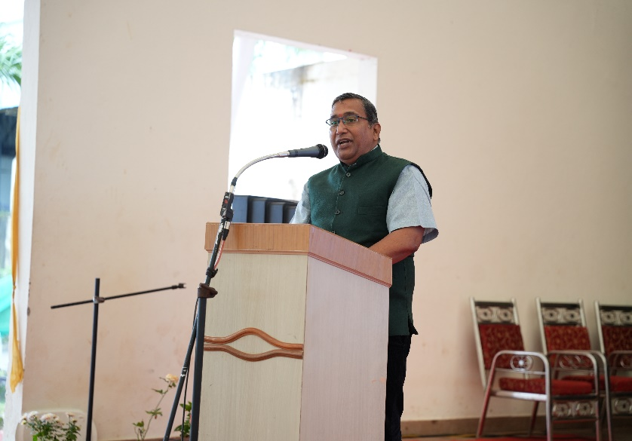
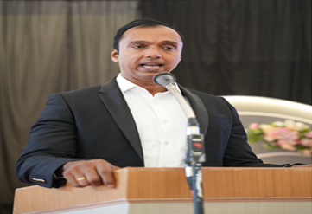
SRINIVAS INSTITUTE OF MEDICAL SCIENCES & RESEARCH CENTRE
SRINIVASNAGAR, MUKKA, SURATHKAL, MANGALORE – 574146. D.K
ADDRESS BY THE PRESIDENT, CHIEF GUEST & OTHERS

Slide 6
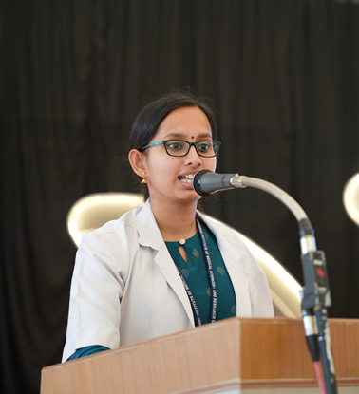
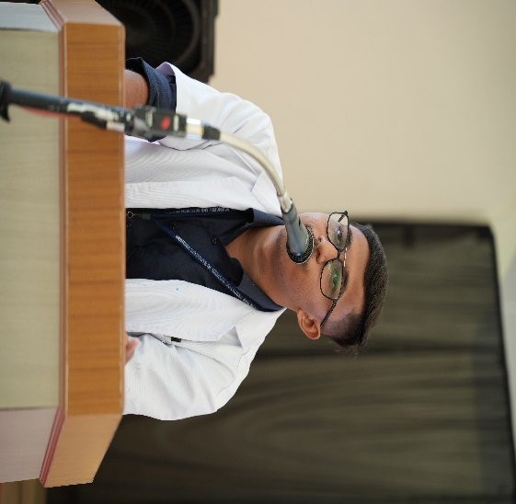
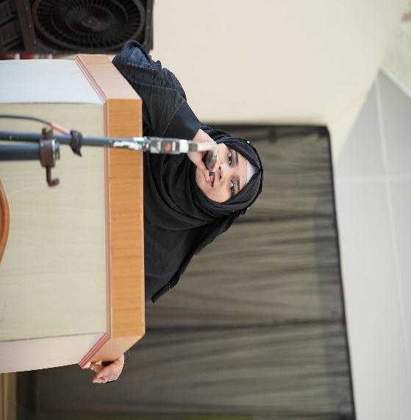
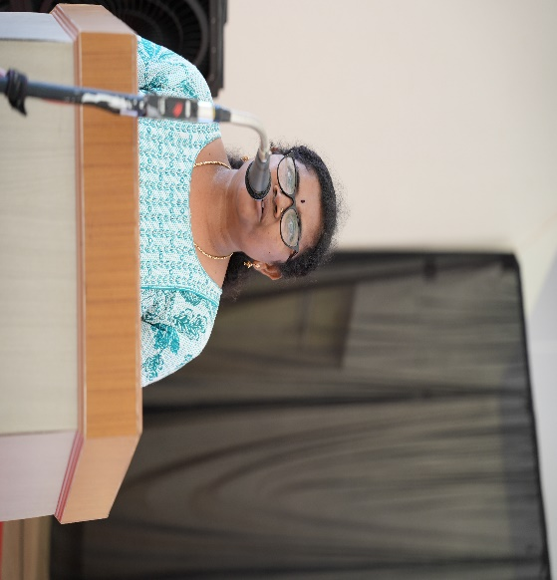
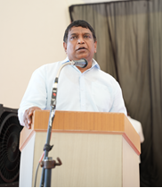
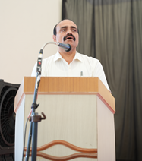
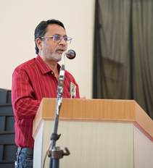
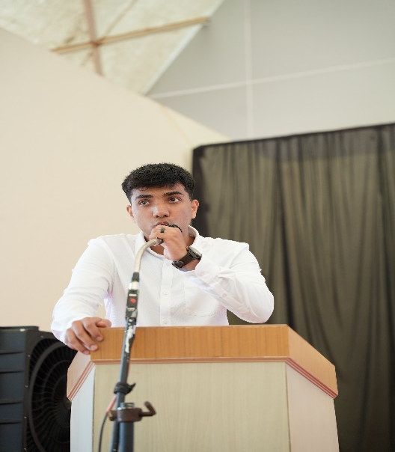
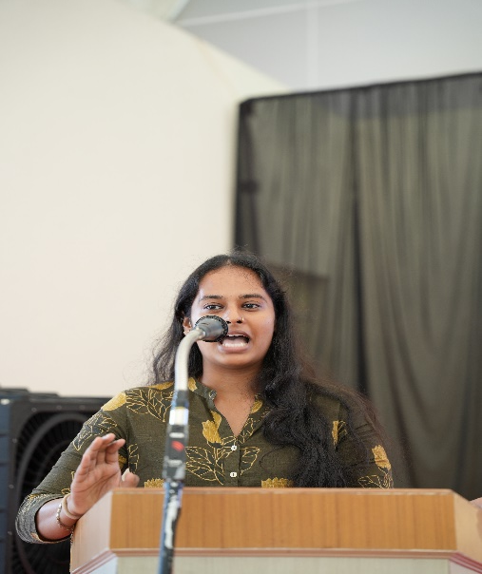
SRINIVAS INSTITUTE OF MEDICAL SCIENCES & RESEARCH CENTRE
SRINIVASNAGAR, MUKKA, SURATHKAL, MANGALORE – 574146. D.K
STUDENTS, FRESHERS & PARENTS’ VIEWS

Slide 7
SRINIVAS INSTITUTE OF MEDICAL SCIENCES & RESEARCH CENTRE
SRINIVASNAGAR, MUKKA, SURATHKAL, MANGALORE – 574146. D.K
THANK YOU

